Slide 1

RUN FOR YOUR LIFE CHALLENGE
BW2 | Activities Roadmap

Slide 2
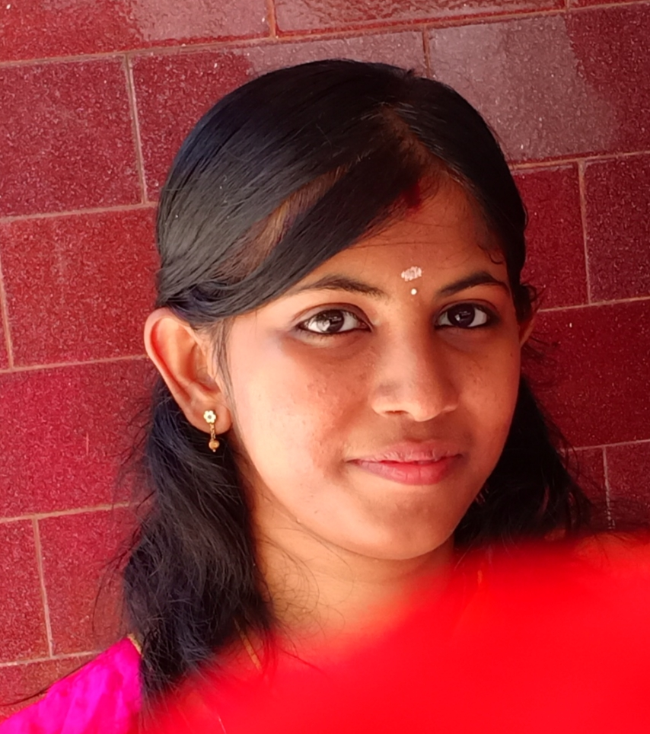

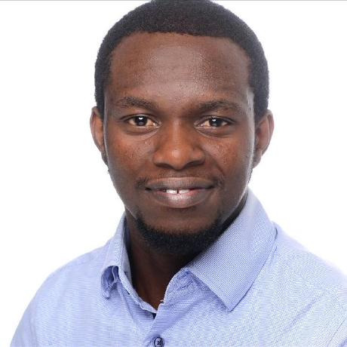
OUR TEAM
RITTHUJA
ANDREA
BW2 | Activities Roadmap
THEOPHILE

Slide 3


TABLE OF ACTIVITIES
01
02
03
EXPLORING DATA
EDA & PREPROCESSING
TUNING THE MODEL & DESIGN THE APP
BW2 | Activities Roadmap

Slide 4
STEP 1: EXPLORING DATA
Understanding the data
Collection and Pre-processing Methods
Creating Metadata about sensors' outputs
BW2 | Activities Roadmap

Slide 5
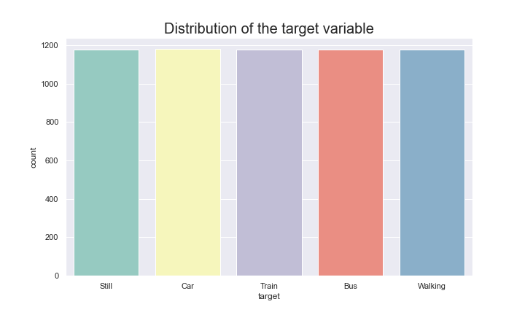
STEP 2: EDA
TARGET
BW2 | Activities Roadmap

Slide 6
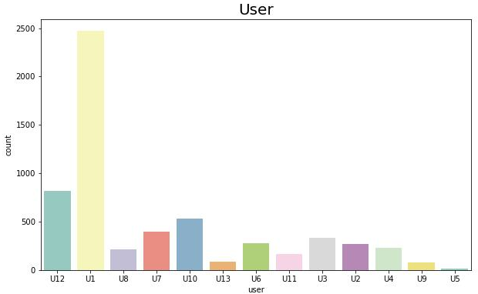
STEP 2: EDA
USERS
BW2 | Activities Roadmap

Slide 7
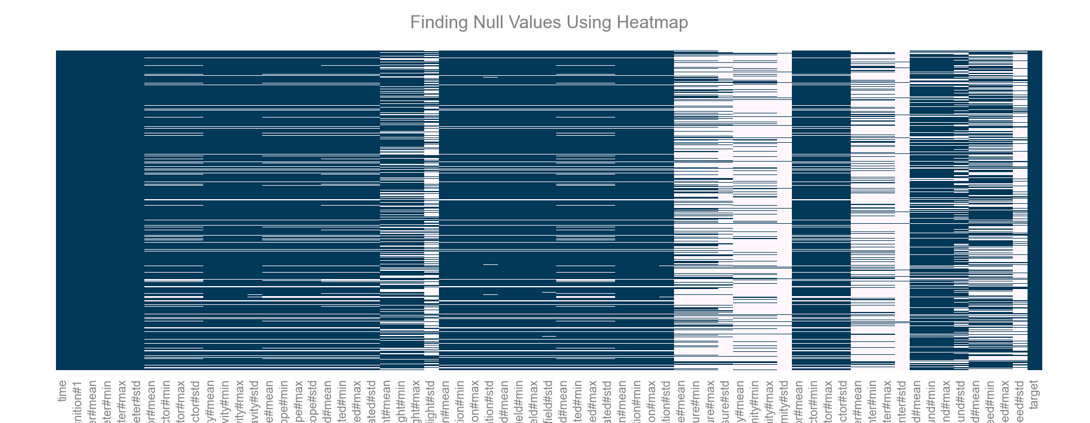
STEP 2: EDA
MISSING DATA
BW2 | Activities Roadmap

Slide 8
STEP 2: PRE-PROCESSING
Cleaning data
Creating functions and pipelines
Trying out first chosen models
Missing value imputation
BW2 | Activities Roadmap

Slide 9
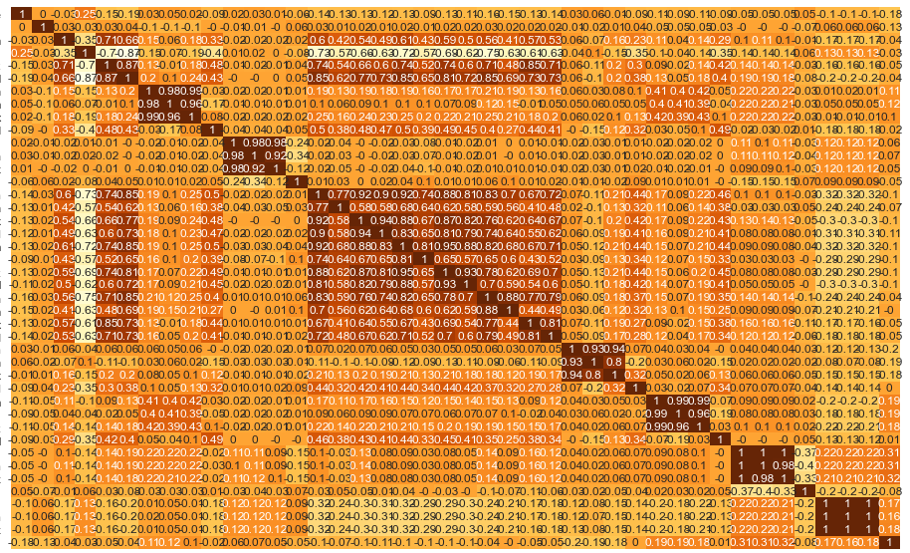
STEP 2: EDA
CORRELATION MATRIX
BW2 | Activities Roadmap

Slide 10
STEP 3: TUNING THE MODEL & DESIGN THE APP
Improving data exploration
Starting the Streamlit app
Improving model accuracy
BW2 | Activities Roadmap

Slide 11
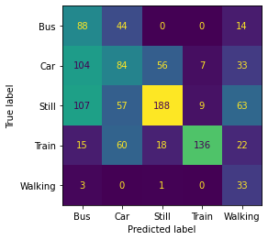
STEP 3: TUNING THE MODEL & DESIGN THE APP
Confusion Matrix
55% accuracy with SVM
BW2 | Activities Roadmap

Slide 12
THANKS
Any questions?
BW2 | Activities Roadmap

